Slide 1
Transmembrane Portein Detection With Neural Networks
Majid Alikhani
200408419

Slide 2
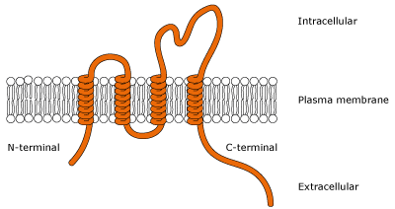
Problem
Definition
Proteins passing through the membrane of the cell
Contain a marker called TM-Domain
Proteins presented as Strings
TM domain is delimited
Example
MNAKYDTDQGVGR)MLFLGTIGLAVVVGGLMAYGY(YYDGKTPSSGTSFHTASPSFSSRYRY

Slide 3
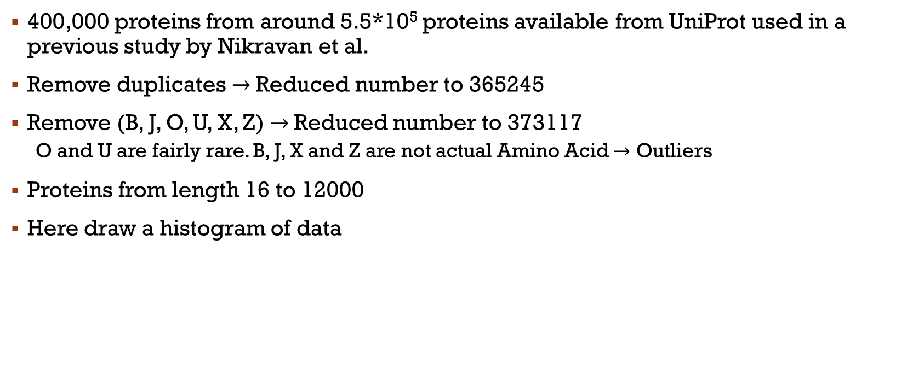
Data
400,000 proteins from around 5.5*10⁵ proteins available from UniProt used in a previous study by Nikravan et al.
Remove duplicates $→$Reduced number to 365245
Remove (B, J, O, U, X, Z) $→$Reduced number to 373117
O and U are fairly rare. B, J, X and Z are not actual Amino Acid $→$ Outliers
Proteins from length 16 to 12000
Here draw a histogram of data

Slide 4
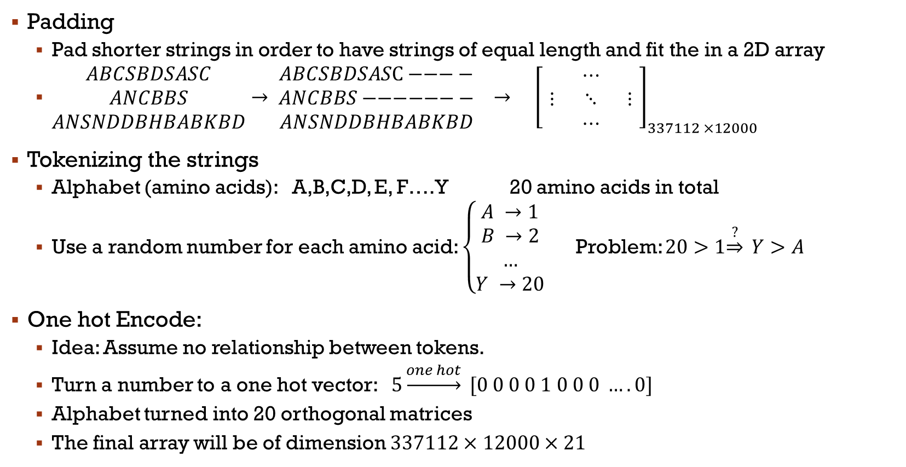
Preprocessing
Padding
Pad shorter strings in order to have strings of equal length and fit the in a 2D array
$\begin{matrix}ABCSBDSASC \\ ANCBBS \\ ANSNDDBHBABKBD\end{matrix}→ \begin{matrix}ABCSBDSAS\text{C}−−−− \\ ANCBBS−−−−−−− \\ ANSNDDBHBABKBD\end{matrix} → {\left[\begin{matrix} & ⋯ & \\ ⋮ & ⋱ & ⋮ \\ & ⋯ & \end{matrix}\right]}_{337112 ×12000}$
Tokenizing the strings
Alphabet (amino acids): A,B,C,D, E, F….Y 20 amino acids in total
Use a random number for each amino acid: $\left\{\begin{aligned}A →1 \\ B →2 \\ … \\ Y →20\end{aligned}\right.$ Problem: $20>1\underset{⇒}{?} Y>A$
One hot Encode:
Idea: Assume no relationship between tokens.
Turn a number to a one hot vector: $5\underset{→}{one hot} [0 0 0 0 1 0 0 0 …. 0]$
Alphabet turned into 20 orthogonal matrices
The final array will be of dimension $337112×12000×21$

Slide 5

Preprocessing
Padding
Pad shorter strings in order to have strings of equal length and fit the in a 2D array
$\begin{matrix}ABCSBDSASC \\ ANCBBS \\ ANSNDDBHBABKBD\end{matrix}→ \begin{matrix}ABCSBDSAS\text{C}−−−− \\ ANCBBS−−−−−−− \\ ANSNDDBHBABKBD\end{matrix} → {\left[\begin{matrix} & ⋯ & \\ ⋮ & ⋱ & ⋮ \\ & ⋯ & \end{matrix}\right]}_{337112 ×12000}$
Tokenizing the strings
Alphabet (amino acids): A,B,C,D, E, F….Y 20 amino acids in total
Use a random number for each amino acid: $\left\{\begin{aligned}A →1 \\ B →2 \\ … \\ Y →20\end{aligned}\right.$ Problem: $20>1\underset{⇒}{?} Y>A$
One hot Encode:
Idea: Assume no relationship between tokens.
Turn a number to a one hot vector: $5\underset{→}{one hot} [0 0 0 0 1 0 0 0 …. 0]$
Alphabet turned into 21 orthogonal matrices
The final array will be of dimension $337112×12000×21$

Slide 6
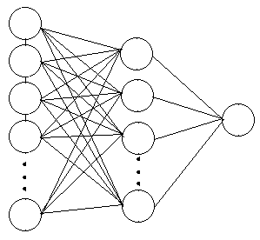
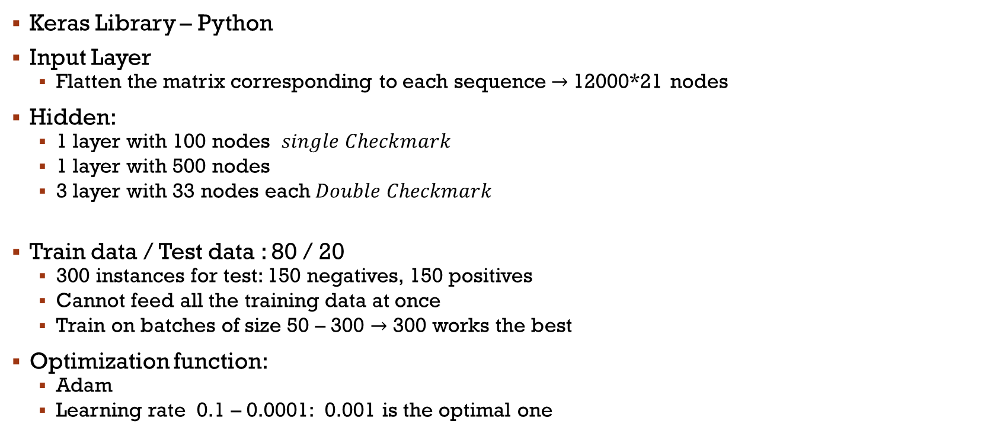
First Network
Keras Library – Python
Input Layer
Flatten the matrix corresponding to each sequence$→$12000*21 nodes
Hidden:
1 layer with 100 nodes $single Checkmark$
1 layer with 500 nodes
3 layer with 33 nodes each$Double Checkmark$
Train data / Test data : 80 / 20
300 instances for test: 150 negatives, 150 positives
Cannot feed all the training data at once
Train on batches of size 50 – 300 $→$300 works the best
Optimization function:
Adam
Learning rate 0.1 – 0.0001: 0.001 is the optimal one

Slide 7
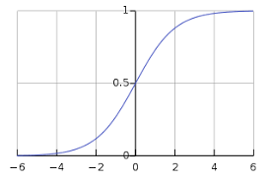
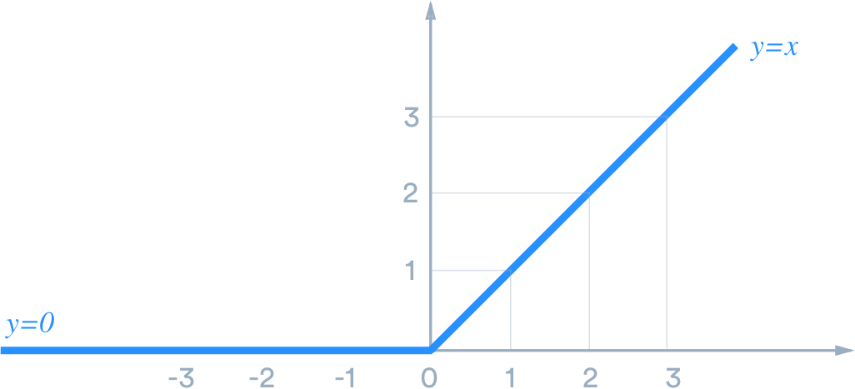
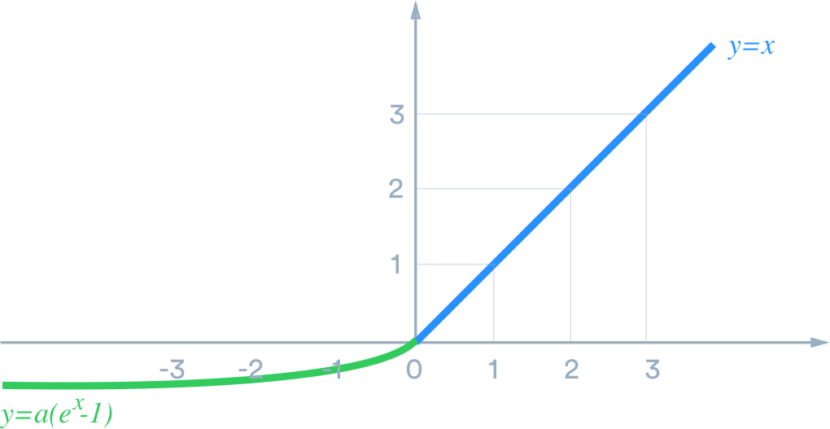
First Network
Sigmoid activation:
Dead Gradient issue
Used in last node for probability prediction
Relu activation function:
Slow learning
Stagnating
Elu Activation:
Obviate stagnation

Slide 8
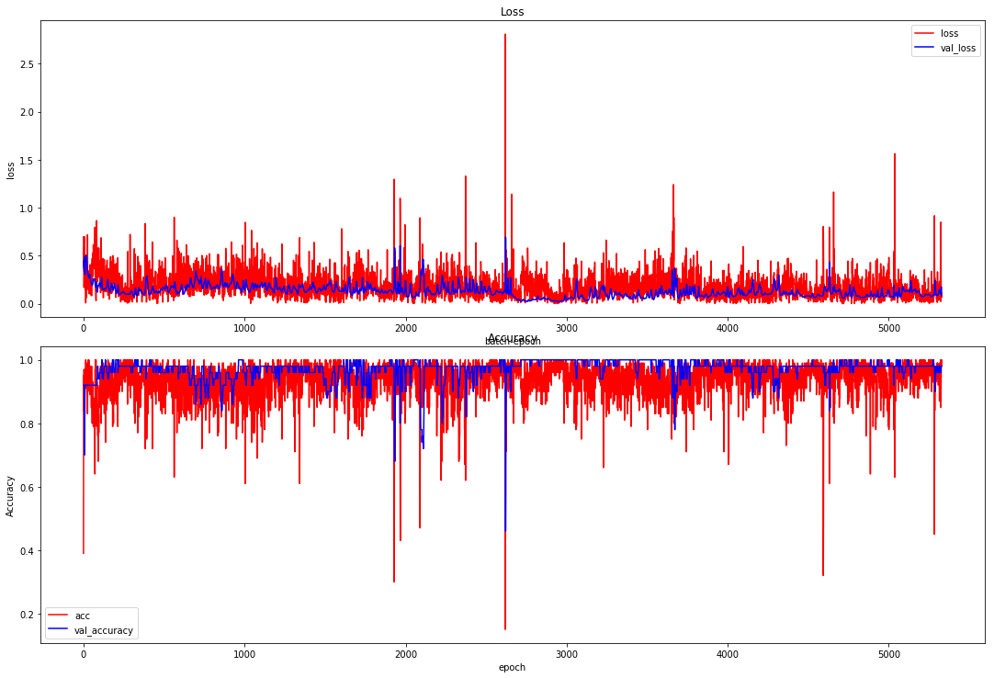
First Network
Epochs:
Number of times the whole data is processed: 2
Best results:
Loss
Accuracy
Plot of accuracy:

Slide 9
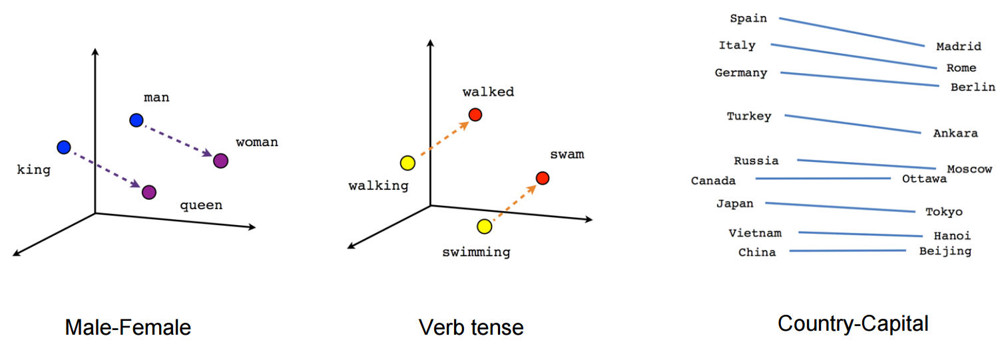
Second Network-embedding
Problem with one hot encoding:
One hot encoding grows the size of input by a great factor
Sparse representation of data
The one hot vectors being orthogonal suggests that they are totally unrelated
Embedding layer
Idea: Vectors of smaller size can squeeze the information
Similarities and differences of words on syntactic and semantic can be represented in vector space (figure)
This vectors can be learned as part of the training process

Slide 10
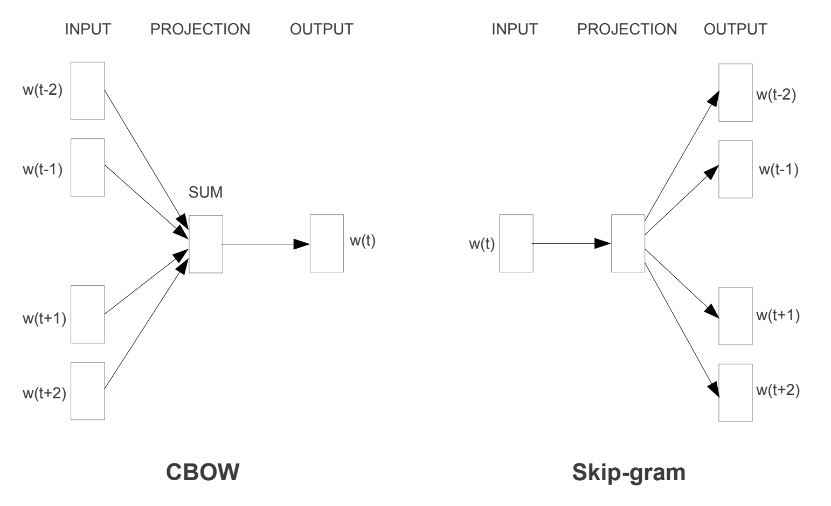
Second Network-Embedding
Learn a word from its context (a window of adjacent words)
Word2Vec (Tomas Mikolov et al, Google 2013)
CBOW: Continuous bag of words
Skip-Gram: predict the surrounding words based on
current word
GloVe (Pennington et al, Stanford)
Considering only a window might not be good
enough
Construct a co-occurrence matrix across the whole text corpus

Slide 11
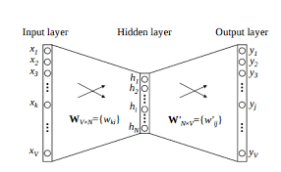
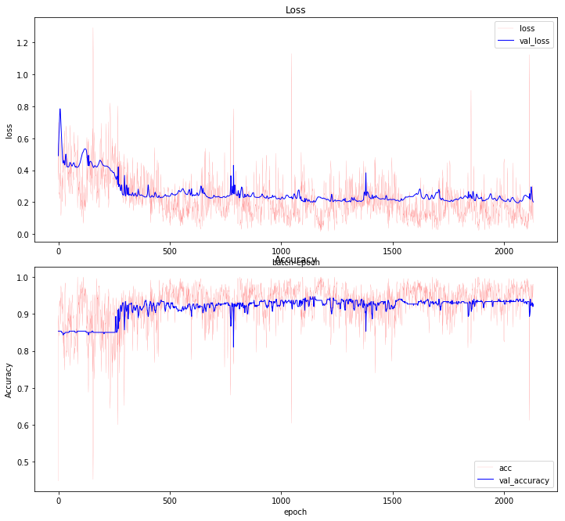
Second Network-Embedding
Model:
Embedding in our model:
Input_dim: 12000
Output dim: 3-5-10, 3 worked the best
Dense layer: 3*33
Learning rate: 0.001
Batchsize: 300
Epochs: 2
Accuracy: 0.92 – 0.87
Loss: 2.02 – 3.54
Dropout added: (0.2- 0.3- 0.4)
Accurcay: 0.95 – 0.96
Loss : 1.15 – 1.65

Slide 12
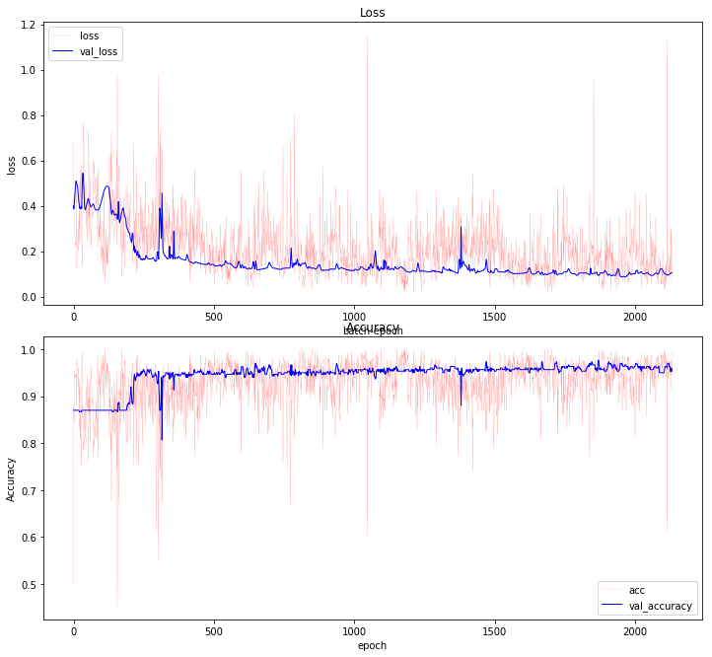
Second Network-Embedding(Dropout comparison)
With Dropout
Without Dropout

Slide 13
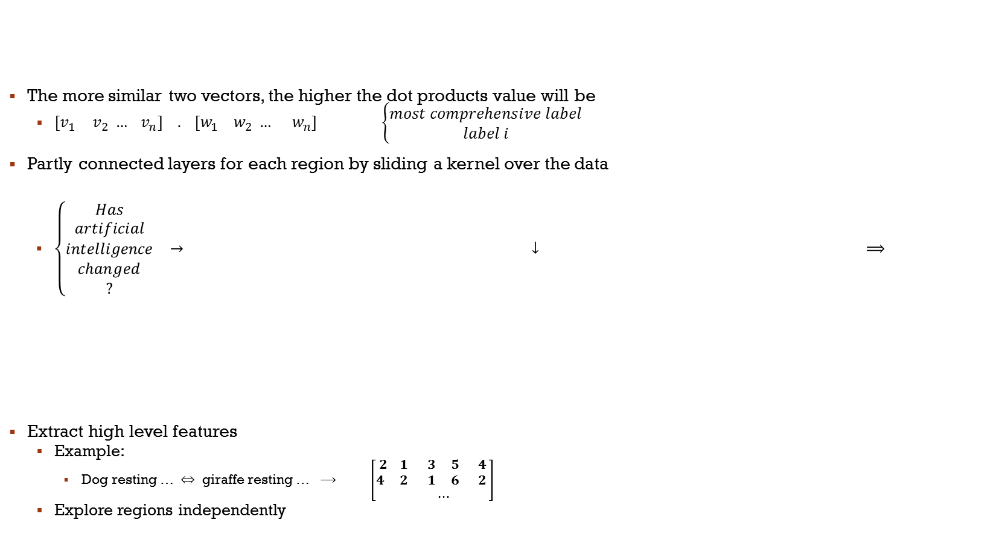
Third Network-Convolutional layers
The more similar two vectors, the higher the dot products value will be
$\begin{matrix}{[v}_{1} & v_{2} … v_{n}] . [w_{1} w_{2} … w_{n}]\end{matrix} \left\{\begin{aligned}most comprehensive label \\ label i\end{aligned}\right.$
Partly connected layers for each region by sliding a kernel over the data
$\left\{\begin{aligned}Has \\ artificial \\ intelligence \\ changed \\ ?\end{aligned}\right.$ $→$ $↓$ $⟹$
Extract high level features
Example:
Dog resting … $⇔$ giraffe resting … $⟶$ $\left[\begin{matrix}2 1 & 3 5 & 4 \\ 4 2 & 1 6 & 2 \\ & ⋯ & \end{matrix}\right]$
Explore regions independently
5 | 2 | 5 | 6 | 1
2 | 15 | 7 | 3 | 9
25 | 12 | 3 | 6 | 10
5 | 3 | 1 | 8 | 9
14 | 3 | 19 | 2 | 1
W1 | W2 | W3 | W4 | W5
W6 | W7 | W8 | W9 | W10
W11 | W12 | W13 | W14 | W15

Slide 14

Third Network-Convolutional layers
Pooling layer:
Turn each region of the matrix to a single value
Max pooling, Average pooling, etc.
Benefits:
Reduce dimension thus prevent over fitting
Time efficiency
If the feature exist in the region of question, the activations are high and therefore the feature will be preserved by pooling as well as when the feature does not exist, the low value for pooling preserves that.
15
2
10
$→$
15
10

Slide 15
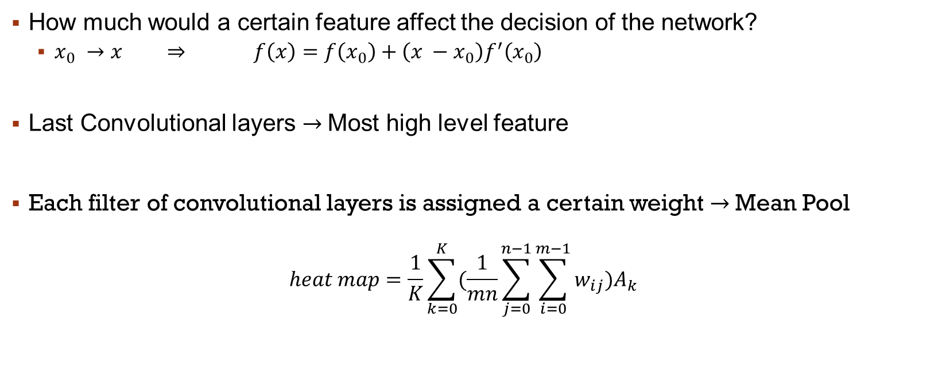
Interpretation
How much would a certain feature affect the decision of the network?
$x_{0} →x ⇒ f\left(x\right)=f\left(x_{0}\right)+\left(x −x_{0}\right)f^{′}\left(x_{0}\right)$
Last Convolutional layers $→$Most high level feature
Each filter of convolutional layers is assigned a certain weight $→$Mean Pool
$$heat map=\frac{1}{K}\sum_{k=0}^{K}{(\frac{1}{mn}\sum_{j=0}^{n−1}{\sum_{i=0}^{m−1}{w_{ij})A_{k}}}}$$

